Slide 1
Choosing the Right Pricing Strategy in 2026
In today's hyper-competitive marketplace, pricing is no longer just a number on a tag—it's a strategic weapon that can make or break your business. As we navigate the complexities of 2026, understanding how to price your products and services effectively has become more critical than ever. This presentation will guide you through the evolving landscape of pricing strategies, emerging trends powered by AI and data analytics, and proven frameworks for making pricing decisions that drive sustainable growth. Whether you're launching a new product, optimizing an existing portfolio, or simply looking to strengthen your competitive position, the insights ahead will equip you with the knowledge and tools to transform pricing from a tactical afterthought into a strategic advantage.

Slide 2
Why Pricing Strategy Matters More Than Ever
11.1%
The numbers speak for themselves: pricing improvements deliver more bottom-line impact than reducing costs or increasing sales volume. Research consistently shows that a mere 1% improvement in pricing can boost operating profit by 11.1%—a magnitude that dwarfs the impact of similar improvements in other business levers. This isn't just about charging more; it's about charging smarter.
Boost in operating profit from just a 1% pricing improvement
But pricing strategy extends far beyond immediate profit margins. Your pricing fundamentally shapes how customers perceive your brand, whether they trust your value proposition, and ultimately, whether your business survives in the long term. In an era where customers have unprecedented access to information and alternatives, strategic pricing has become the intersection where profit maximization meets customer psychology, competitive dynamics, and market positioning.
Profit Amplifier
Brand Positioning
Trust Foundation
Price optimization delivers exponentially higher returns than cost reduction or volume increases, directly impacting your bottom line with minimal operational overhead.
Your pricing communicates quality, exclusivity, and value, shaping customer expectations and influencing purchase decisions before they even experience your product.
Transparent, fair pricing builds customer confidence and loyalty, while arbitrary or confusing pricing erodes trust and drives customers to competitors.

Slide 3
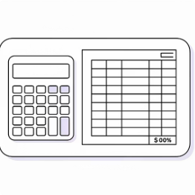

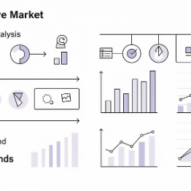
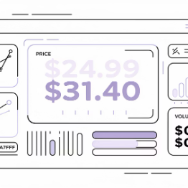
The Pricing Strategy Landscape: More Than Just Cost-Plus
The days of simple cost-plus pricing—where you add a standard markup to your production costs and call it a day—are rapidly fading. While this approach offers simplicity and ensures basic profitability, it completely ignores two critical factors: what customers are willing to pay and what competitors are charging. Today's sophisticated pricing landscape offers multiple strategic approaches, each suited to different business contexts and market conditions.
Cost-Plus Pricing
Value-Based Pricing
Competitive Pricing
Dynamic Pricing
The traditional approach that adds a fixed margin to production costs. Simple to implement and ensures profitability, but ignores customer value perception and competitive dynamics. Best suited for commodity products or industries with standardized pricing expectations.
Adjusts prices in real-time based on demand, inventory levels, customer segments, or market conditions. Powered by algorithms and AI, this approach maximizes revenue by charging what the market will bear at any given moment. Common in travel, hospitality, and e-commerce.
Sets prices based on perceived customer value rather than costs. Dominant in emotional or premium markets where brand, experience, and outcomes matter more than features. Requires deep customer understanding but can unlock significantly higher margins.
Aligns with or strategically undercuts competitors to capture market share. Essential in crowded markets where customers actively comparison shop. Requires constant market monitoring and the agility to respond to competitive moves quickly.

Slide 4
2026 Pricing Trends You Can't Ignore
The pricing landscape is evolving rapidly, driven by technological advances, changing customer expectations, and new business models. As we progress through 2026, four major trends are reshaping how innovative companies approach pricing strategy. These aren't distant future predictions—they're happening now, and businesses that fail to adapt risk being left behind by more agile competitors.
Hybrid Subscription Models
Radical Simplification
The most sophisticated companies are moving beyond pure subscription or pure usage-based models, instead blending both approaches. This hybrid model offers customers the predictability of a base subscription while adding usage-based components that ensure fairness—customers only pay more when they receive more value. SaaS companies, cloud services, and even traditional B2B businesses are adopting this approach to balance revenue stability with customer satisfaction. The result: higher retention rates and more aligned value exchange.
In response to customer frustration with complex pricing tiers and hidden fees, leading brands are dramatically simplifying their pricing structures. By cutting unnecessary complexity, these companies are accelerating sales cycles, reducing customer support inquiries, and improving transparency. This trend reflects a broader shift toward customer-centric design in all aspects of business. The companies winning with simplification understand that clear pricing isn't just easier to understand—it's a competitive advantage that builds trust and reduces friction at the moment of purchase decision.
Outcome-Based Pricing
AI-Powered Optimization
Rather than charging for inputs, activities, or time, outcome-based pricing ties fees directly to the results delivered for customers. This model is gaining traction across professional services, B2B SaaS, and consulting as AI and data analytics make it easier to measure and attribute outcomes. When done right, outcome-based pricing aligns incentives perfectly: the vendor only wins when the customer wins. This builds extraordinary trust and partnership dynamics, though it requires robust measurement frameworks and confidence in your ability to deliver results.
Artificial intelligence is transforming pricing from a periodic strategic exercise into a continuous optimization process. Modern AI pricing tools analyze vast datasets—competitor prices, demand signals, customer behavior, inventory levels, and market conditions—to recommend optimal price points in real-time. These systems can manage millions of SKUs, test pricing variations at scale, and optimize discount strategies dynamically. Early adopters are seeing margin improvements of 3-8% within months of implementation, and the technology is becoming more accessible to mid-market companies.

Slide 5

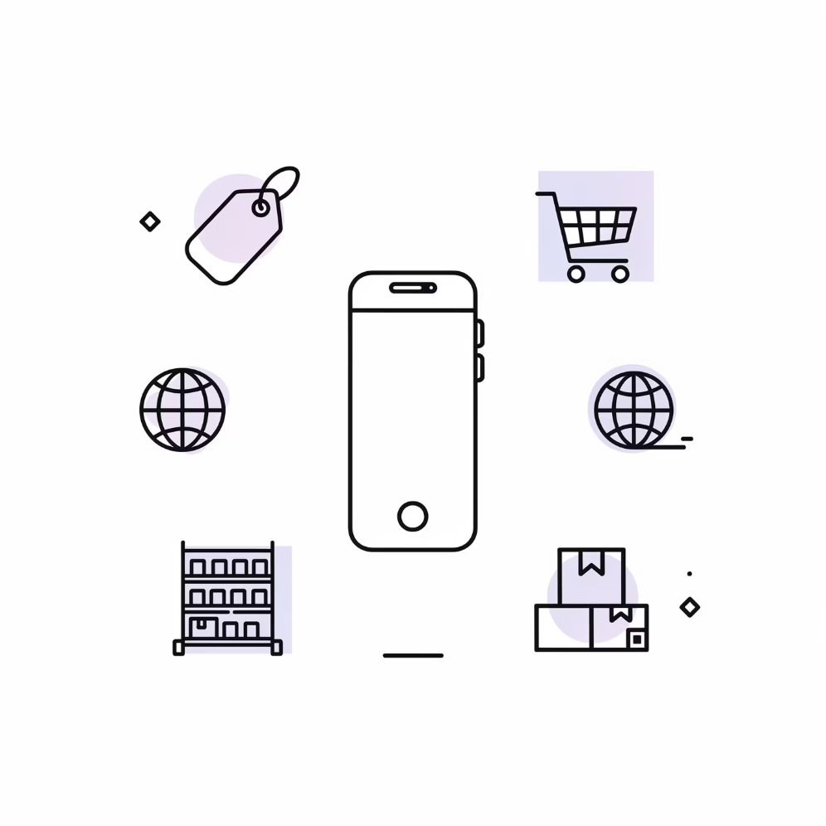

New Product Pricing Strategies: First Impressions Last
When launching a new product, your initial pricing decision sets the trajectory for everything that follows: brand perception, target customer segments, competitive positioning, and long-term profitability potential. This isn't a decision to make lightly or to delegate to a spreadsheet. The two dominant approaches—price skimming and market penetration—represent fundamentally different philosophies, each with distinct advantages and risks.
Price Skimming Strategy
Market Penetration Pricing
Price skimming starts with premium pricing to capture early adopters who value innovation and are willing to pay a premium for being first. As the market matures and competition enters, prices gradually decrease to capture more price-sensitive segments. This approach is ideal for truly innovative products with limited competition, where early adopters provide valuable feedback and word-of-mouth marketing. Technology companies frequently use this strategy—think of new iPhone launches or cutting-edge electronics.
Market penetration takes the opposite approach: launch with aggressively low prices to quickly build market share, volume, and brand awareness. Once you've established market position and customer loyalty, you can gradually raise prices. This strategy works best in price-sensitive markets with potential for economies of scale, where the goal is to achieve rapid adoption and make it difficult for competitors to gain a foothold.
Best for: Innovative products, markets with distinct customer segments, situations where brand premium matters, and products with high R&D costs to recoup quickly.
Best for: Commoditized markets, situations where scale drives unit economics, products with strong network effects, and competitive landscapes where first-mover advantage is critical.
The AI Advantage in New Product Pricing
Modern AI tools have transformed new product pricing from educated guesswork into data-driven science. These platforms can simulate different pricing scenarios, predict demand curves across various price points, and even optimize timing for price adjustments post-launch. By analyzing historical data from similar product launches and real-time market signals, AI helps reduce the risk of mispricing and accelerates time to optimal pricing. Leading companies now use these tools to A/B test pricing strategies in limited markets before full rollout, dramatically improving pricing success rates.

Slide 6
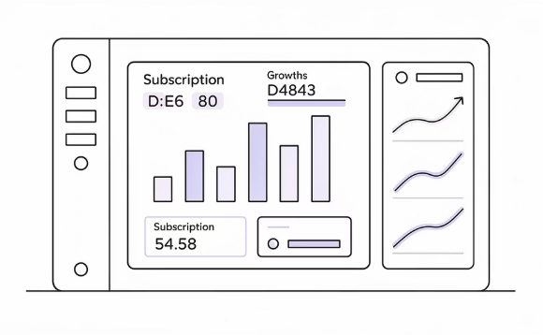
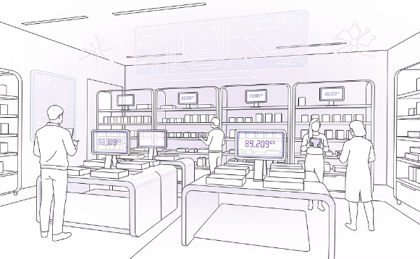

Real-World Success: How Strategic Pricing Drives Growth
Theory is valuable, but nothing beats real-world evidence. Across industries, companies that treat pricing as a strategic discipline rather than a tactical afterthought are seeing remarkable results. These success stories illustrate how different pricing approaches can unlock growth, improve margins, and strengthen customer relationships when executed thoughtfully.
SaaS Hybrid Pricing Transformation
AI-Powered Retail Margin Optimization
Legal Services AI Rate Optimization
A mid-market B2B SaaS company transitioned from pure seat-based pricing to a hybrid model combining base subscriptions with usage-based components. The results were striking: revenue predictability improved by 34% as the base subscription provided stable recurring revenue, while usage-based fees grew with customer success. Customer satisfaction scores increased by 18 points because customers perceived the pricing as fairer—they only paid more when they extracted more value. The model also reduced churn by 22% as customers felt less locked into expensive plans they weren't fully utilizing. The company's sales cycle shortened by 12 days because the pricing structure was easier to understand and aligned better with how customers thought about value.
Several major retailers implemented AI-driven pricing tools to optimize markdown strategies, promotional pricing, and competitive positioning across tens of thousands of SKUs. By analyzing historical sales data, competitor prices, inventory levels, and demand signals, the AI systems recommended optimal price points for each product at each location in real-time. The results were extraordinary: margin improvements ranged from 45% to 60% within the first year of implementation. These gains came not from blanket price increases, but from smarter pricing—raising prices where demand was inelastic, executing more strategic markdowns that cleared inventory without leaving money on the table, and responding to competitive moves with precision rather than panic. The systems also identified products that were systematically underpriced relative to customer willingness to pay.
Leading law firms began integrating AI tools to optimize rate setting, partner compensation, and client negotiations. These platforms analyzed historical matter data, client feedback, competitive rates, and outcome value to recommend pricing strategies for different practice areas and client types. Firms using these tools reported multiple benefits: stronger client trust as pricing became more transparent and justified by value delivered rather than arbitrary hourly rates; higher rate realization as lawyers had data-backed confidence to hold firm on rates; improved profitability as the firms could identify and emphasize high-value, high-margin practice areas; and better partner alignment as compensation models incorporated value-based metrics alongside billable hours. The transformation represented a fundamental shift from time-based to value-based pricing in an industry historically resistant to change.

Slide 7

The Psychology Behind Pricing: Jobs To Be Done Framework
Great pricing isn't just about economics—it's deeply rooted in human psychology. The Jobs To Be Done (JTBD) framework provides a powerful lens for understanding what customers are really paying for when they purchase your product or service. Customers don't buy products; they "hire" them to accomplish specific jobs in their lives, and these jobs span functional, emotional, and social dimensions.
Understanding Customer Jobs
When a customer buys a premium laptop, the functional job might be "process data efficiently," but the emotional job could be "feel confident in my work capabilities," and the social job might be "project professional success to colleagues." Effective pricing must reflect the total value delivered across all these dimensions, not just the cost of components and assembly. A $2,000 laptop might cost $600 to manufacture, but if it delivers $5,000+ in perceived value across functional, emotional, and social jobs, the pricing is justified.
This framework explains why seemingly identical products command vastly different prices. A $20 plain white t-shirt and a $200 designer t-shirt might be functionally identical, but they perform very different emotional and social jobs. The key insight: pricing should be anchored to job value, not product cost.
The Power of Price Anchoring
Price anchoring leverages cognitive biases to influence perception of value. Controlled experiments consistently show that highlighting reference points—whether showing the "original" price crossed out, displaying competitor prices, or featuring the savings amount—can increase conversion rates by over 20%. The anchor provides context that helps customers evaluate whether your price represents a good deal. Without an anchor, customers struggle to assess value and often default to lower prices out of uncertainty.
Functional Jobs
The practical, tangible outcomes customers need: save time, increase efficiency, solve a problem, accomplish a task.
Emotional Jobs
How customers want to feel: confident, secure, successful, creative, in control, sophisticated.
Social Jobs
How customers want to be perceived by others: professional, successful, responsible, innovative, discerning.

Slide 8
How to Choose Your Pricing Strategy: A Step-by-Step Approach
Choosing the right pricing strategy isn't a one-time decision made in isolation—it's a systematic process that requires analyzing multiple dimensions of your business, market, and customers. This six-step framework provides a structured approach to developing a pricing strategy that balances profitability with market realities and customer value perception.
01
02
Understand Your Costs and Profit Goals
Analyze Competitors' Pricing and Market Positioning
Start with the fundamentals: calculate your true costs including direct materials, labor, overhead, and fully-loaded operational expenses. Then define your target profit margins and break-even thresholds. This establishes your pricing floor—the minimum viable price below which your business model doesn't work. While cost shouldn't be your only pricing consideration, you can't afford to ignore it. Factor in not just current costs but projected costs as you scale, and understand which cost components are fixed versus variable to inform volume-based pricing decisions.
Conduct thorough competitive analysis to understand the pricing landscape. Document not just competitors' list prices but their actual transaction prices, discount patterns, pricing structure complexity, and value propositions. Identify how competitors position themselves—premium, value, or commodity—and understand the market dynamics that drive their pricing choices. This analysis helps you identify white space opportunities, understand customer price expectations, and determine whether you're competing on price, value, or differentiation. Use tools to monitor competitive prices continuously, as markets shift quickly.
03
04
Identify Target Customers' Value Perception and Price Sensitivity
Consider Your Business Model and Long-Term Goals
This is often the most overlooked step, yet it's critical. Conduct customer research to understand how different segments perceive your value relative to alternatives. Use conjoint analysis, Van Westendorp pricing surveys, or direct customer interviews to quantify willingness to pay. Segment customers by price sensitivity—some care deeply about price, others prioritize convenience, quality, or brand. Understanding these segments allows you to develop tiered pricing or identify opportunities for price discrimination. Don't assume you know what customers will pay; validate with data.
Your pricing strategy must align with your broader business strategy. Are you optimizing for rapid growth, market share, or profitability? Is your model based on recurring revenue, one-time transactions, or hybrid? Are you building a premium brand or pursuing volume-based scale? These strategic considerations should drive pricing choices. A startup seeking rapid user acquisition might pursue penetration pricing despite lower initial margins, while an established brand might use premium pricing to maintain exclusivity. Ensure pricing supports rather than undermines your long-term vision.
05
06
Test Pricing Variations and Gather Data
Use AI Tools to Refine and Forecast Pricing Impact
Never commit to pricing based on theory alone—test in the real market. Use A/B testing to compare conversion rates at different price points. Run limited-geography experiments to validate demand curves. Implement pilot programs with select customer segments to gather feedback on pricing structure and perceived value. The digital economy makes testing easier than ever; e-commerce sites can test pricing variations in real-time, while B2B companies can pilot new pricing with specific accounts. The key is to establish clear success metrics before testing and give experiments enough time to generate statistically significant results.
Modern AI and analytics platforms can dramatically improve pricing decisions by analyzing datasets too large and complex for manual analysis. These tools can simulate pricing scenarios, forecast demand at different price points, optimize discount strategies, and identify pricing opportunities across product lines. They can also monitor market conditions and competitor moves in real-time, alerting you to threats and opportunities. Investing in pricing analytics isn't just for enterprise companies anymore—accessible SaaS tools now serve mid-market businesses. The ROI on these investments is often measured in months, not years.

Slide 9

Common Pitfalls to Avoid
Even experienced business leaders make critical pricing mistakes that undermine profitability and growth. Understanding these common pitfalls helps you avoid costly errors that can take years to correct. Many of these mistakes stem from treating pricing as a tactical task rather than a strategic discipline, or from organizational inertia that prevents necessary pricing evolution.
1
2
3
4
Cost-Only Pricing Myopia
Complexity Creep
Poor Communication
Set-It-and-Forget-It Syndrome
One of the most pervasive mistakes is focusing exclusively on costs when setting prices, completely ignoring what customers value and what they're willing to pay. This "cost-plus" mentality leads to either leaving money on the table when your value proposition is strong, or overpricing when your costs are high but customer value perception is low. Your costs are important for determining feasibility, but customer value should drive pricing. A $100 product that costs $20 to make but delivers $500 in customer value is underpriced, even with an 80% margin. Conversely, a $100 product that costs $80 but only delivers $90 in value is overpriced, even at just a 25% margin. Always anchor pricing to value delivered, not costs incurred.
Over time, many companies accumulate layers of pricing complexity—multiple tiers, numerous add-ons, various discount structures, exception pricing for different customer types, promotional pricing, and special deals. This complexity might seem like sophisticated revenue optimization, but it often backfires spectacularly. Complex pricing confuses customers, slows down sales cycles as prospects struggle to understand options, increases customer support burden, creates internal alignment challenges, and makes it nearly impossible to analyze pricing effectiveness. Each layer of complexity is often added with good intentions, but the cumulative effect is paralysis. Regularly audit your pricing structure and ruthlessly simplify. The goal isn't to have the most options—it's to make buying easy.
Even when you have a great pricing strategy, failure to communicate the rationale clearly to customers causes problems. Customers who don't understand why they're paying a premium are more likely to churn, negotiate aggressively, or choose competitors. Transparent communication about how prices are set, what drives value, and why your pricing is fair builds trust and justifies premium positioning. This doesn't mean revealing your costs or negotiation strategies—it means helping customers understand the value they're receiving. Create clear pricing pages, train sales teams to articulate value, and proactively address common pricing objections. Companies that communicate pricing rationale effectively see higher conversion rates and lower price sensitivity.
Market conditions evolve constantly: competitors change pricing, customer preferences shift, costs fluctuate, new technologies emerge, and economic conditions change. Yet many companies treat pricing as a one-time decision, failing to revisit and adjust as circumstances change. This inertia can be devastating—you might be dramatically overpriced relative to new competitors, or leaving massive amounts of money on the table as your value proposition strengthens. Establish a regular cadence for pricing review—at minimum quarterly for dynamic markets, at least annually for all businesses. Monitor key indicators: win/loss rates, discount frequency and depth, competitive moves, cost trends, and customer feedback. Pricing should be a continuous optimization process, not a set-and-forget decision.

Slide 10




Your Pricing Strategy Roadmap for 2026 and Beyond
As we've explored throughout this presentation, strategic pricing represents one of the highest-leverage opportunities to drive sustainable business growth. The path forward requires both mindset shifts and practical action. Here's your roadmap for making pricing a competitive advantage in your organization.
Embrace Strategic Pricing as a Core Business Lever
The first and most important step is cultural: elevate pricing from a tactical finance function to a strategic business discipline. This means involving cross-functional teams in pricing decisions, allocating resources to pricing analytics and tools, and making pricing a regular topic in strategic planning discussions. Leaders must champion pricing strategy and hold teams accountable for pricing outcomes, not just volume or cost metrics.
Leverage Data and AI for Continuous Optimization
Invest in pricing analytics capabilities, whether through dedicated software, data science resources, or external consultants. Use these tools to move from intuition-based to data-driven pricing decisions. The goal isn't to replace human judgment but to augment it with insights from analyzing patterns too complex for manual analysis. Start with pilot projects that demonstrate ROI, then scale successful approaches across your portfolio.
Align Pricing with Customer Value and Business Vision
Ensure your pricing strategy directly supports both customer value perception and your long-term business goals. This alignment creates a virtuous cycle: customers who perceive strong value are willing to pay premium prices, which generates resources to invest in further value creation. Regularly validate that your pricing reflects the jobs customers are hiring you to do and supports the brand position you're trying to build.
Start Small with Experiments, Learn Fast, and Scale What Works
Don't attempt to revolutionize your entire pricing structure overnight. Instead, adopt an experimental mindset: identify specific pricing hypotheses to test, design controlled experiments with clear success metrics, run tests in limited markets or segments, analyze results rigorously, and scale successes while learning from failures. This iterative approach reduces risk while accelerating learning and building organizational capability in pricing strategy.
The Right Strategy Sets Tomorrow's Foundation
Ready to Transform Your Pricing?
The pricing decisions you make today create the conditions for tomorrow's success or struggle. Companies that treat pricing strategically build stronger brands, healthier margins, and more sustainable competitive positions. Those that neglect pricing strategy compete on price by default, eroding profitability and limiting growth options.
Begin by auditing your current pricing strategy against the frameworks presented here. Identify your biggest opportunities and highest-risk blind spots. Then take action: test, learn, optimize, and scale. The right pricing strategy isn't found—it's built through disciplined iteration and continuous improvement.
Your journey toward pricing excellence starts with a single step: commit to approaching pricing with the strategic rigor it deserves. The frameworks, trends, and tactics covered in this presentation provide your starting point. The specific path will be unique to your business, but the destination—profitable, sustainable growth through strategic pricing—is worth pursuing.

